Slide 1

Permission Impossible
Dead Reckoning Pain

Slide 2




Slide 3

Shameless Self-Plug
Francis Chung
Co-Organiser of Alt.Net and DDD-AU Meetups
30 years in the industry
My first computer was an Apple II
Notes:
… and I’m an Apple Fanboi … despite doing this presentation using a Fake Apple Laptop

Slide 4
Once upon a time ….

Slide 5

Notes:
FreshBooks is an Accounting Platform, main market US/Canada, 1 million plus users worldwide, worked as a Principal Engineer

Slide 6

An Impossible Mission was given

Slide 7
Introduce a new User Class The FIRM Accountant
Notes:
And if you’re wondering what a Firm Accountant is

Slide 8

Not this Accountant
with the firm grip
Notes:
It’s not this guy

Slide 9

More like this guy with the undeniably Firm Accountant looks … the world can be accrual sometimes
Notes:
Basically like an external Accountatnt or Auditor that shares some but not all access rights as your regular accountant

Slide 10
Analysis
933 potential code changes spanning across 6 systems

Slide 11
Analysis
933 potential code changes spanning across 6 systems
Given 1 intern Developer as a resource

Slide 12
Analysis
933 potential code changes spanning across 6 systems
Given 1 intern Developer as a resource
I wasn’t allowed to code

Slide 13
Analysis
933 potential code changes spanning across 6 systems
Given 1 intern Developer as a resource
I wasn’t allowed to code
I had 2 months to deliver

Slide 14

Your project / sanity will self destruct in ….

Slide 15
Permission Impossible
Dead Reckoning Pain
Notes:
.. and hence … the Title of my talk today

Slide 16

Roughly Speaking …
Notes:
To fast forward 2.5 months later

Slide 17

Project Delivered!

Slide 18

On Reflection …

Slide 19

What I should have done
Notes:
… is to jump out of the building and ran for my life and sanity ….. because of all the meetings, the hair pulling, and battles etc I had to endure along the way. And I wont be talking about those todayas that would be a whole new other talk.

Slide 20
There has to be a better way !
Notes:
And on reflection I thought, there has to be a better way of introducing a new user class to the system. And I could see this was going to happen again in the coming months as FBs introduced new features and inevitable new user classes along the way.

Slide 21
THE END - Part 1
Notes:
So I’ll be talking about a better way of doing this in the next segment of the talk

Slide 22
Part 2 - Deeper Dive

Slide 23

Agenda
Intro - Auth vs Authz
Different Access Control Models
Live Demo (Time permitting)
Q&A at the end

Slide 24
Authentication vs Authorization
Notes:
When you’re talking about Application Security, permissions, identity etc, what you’re really talking about is Authentication and Authorization, which both go hand in hand. But it’s common for people to confuse the 2. So let’s first talk about what these 2 things really are.

Slide 25
Authentication -
Are you who you say you are?
Notes:
In Mission Impossible, Ethan Hunt comes across as a very inauthentic person

Slide 26
Authorization - As user X =>
What are you allowed to do? What AREN’T you allowed to do?
Notes:
A good real life example is. If you’re in a relationship, you’re constantly asking for Authorization from your other half. And in my case when I was in a relationship, it was often constantly denied

Slide 27
Authentication vs Authorization
Notes:
Otherwise this talk would be finished as hopefully everyone should know who I am by now.

Slide 28
Typical Code for checking permissions
def put(self, business_uuid):
if not self.permission.can_update():
raise ForbiddenError
# ... do some updates ...
class <BusinessUnit>Permission(BasePermission):
def can_read(self):
return self.role in [
self.BUSINESS_OWNER_ROLE,
self.BUSINESS_PARTNER_ROLE,
self.ACCOUNTANT_PARTNER_ROLE,
]
def can_update(self):
return self.role in [
self.BUSINESS_OWNER_ROLE,
self.BUSINESS_PARTNER_ROLE,
self.ACCOUNTANT_PARTNER_ROLE,
]
Notes:
Example of the 1 of the 933 places I had to check

Slide 29
Typical Code for checking permissions
def put(self, business_uuid):
if not self.permission.can_update():
raise ForbiddenError
# ... do some updates ...
class <BusinessUnit>Permission(BasePermission):
def can_read(self):
return self.role in [
self.BUSINESS_OWNER_ROLE,
self.BUSINESS_PARTNER_ROLE,
self.ACCOUNTANT_PARTNER_ROLE,
]
def can_update(self):
return self.role in [
self.BUSINESS_OWNER_ROLE,
self.BUSINESS_PARTNER_ROLE,
self.ACCOUNTANT_PARTNER_ROLE,
]
Role Based Security
Role based Access Control
(RBAC)
Notes:
Everyone has seen this type of code before right? Imagine changing / analysing 933 instances of code like this throughout your entire SAAS application

Slide 30
Pros & Cons with RBAC (Role based)
Pros
Simple
Easy to implement
Great for small/medium apps
Well defined Permission Set that doesn’t change

Slide 31
Pros & Cons with RBAC (Role based)
Pros
Simple
Easy to implement
Great for small/medium apps
Well defined Permission Set that doesn’t change
Cons
Not Scalable for Enterprise / SAAS
Difficult to change or introduce new permissions
Simple, Low Granular Permissions
Tight Coupling

Slide 32

Are there Alternatives out there?
Notes:
Just filled my Cat meme Quota. Check.

Slide 33
Attribute Based Access Control (ABAC)
In a Nutshell : -
Method of doing Access Control over attributes across 4 areas using policies
Subject (User)
Resource
Action
Environment
Notes:
So during my research, I can across something called ABAC.

Slide 34
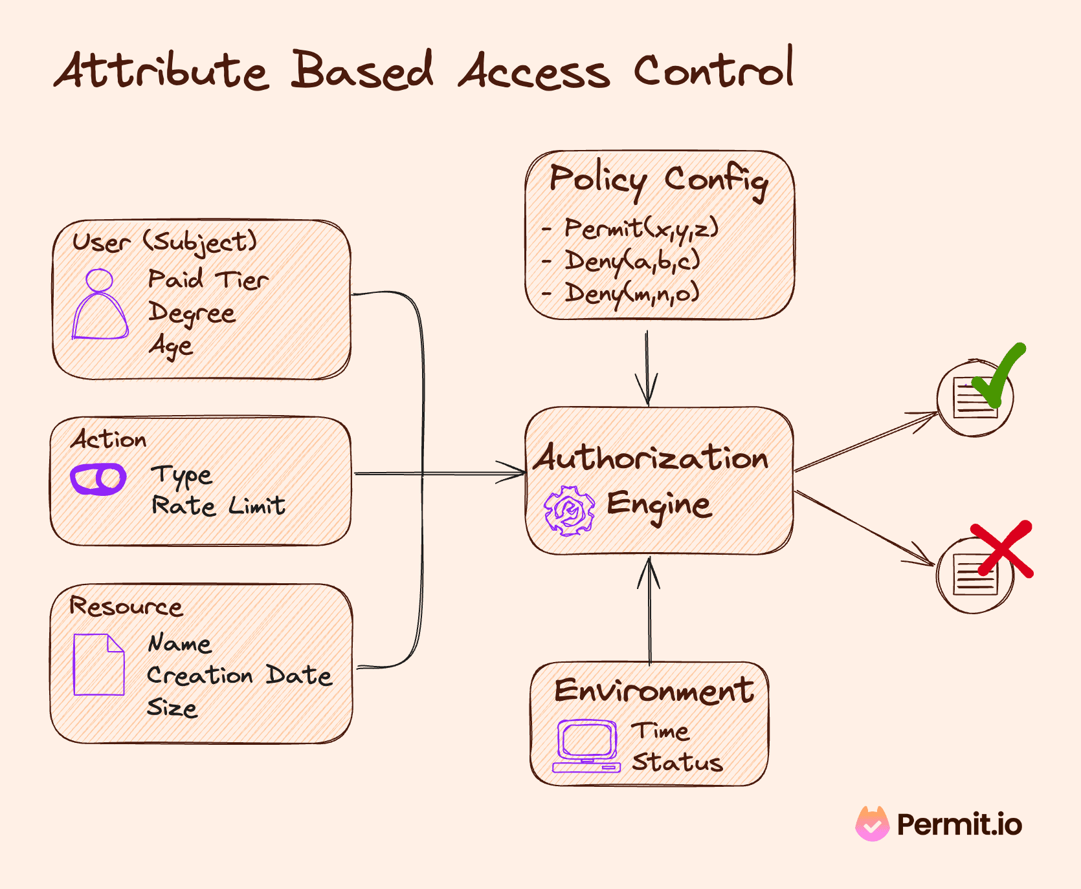

Slide 35
Attribute Based Access Control (ABAC)
Pros
Granular / Flexible Permissions
Scalable
Better Security + Compliance
Centralised

Slide 36
Attribute Based Access Control (ABAC)
Pros
Granular / Flexible Permissions
Scalable
Better Security + Compliance
Centralised
Cons
Complex!
Performance - Latency
XACML - Extensible Access Control Markup Language
Notes:
XACML seems to be standard way of doing ABAC

Slide 37
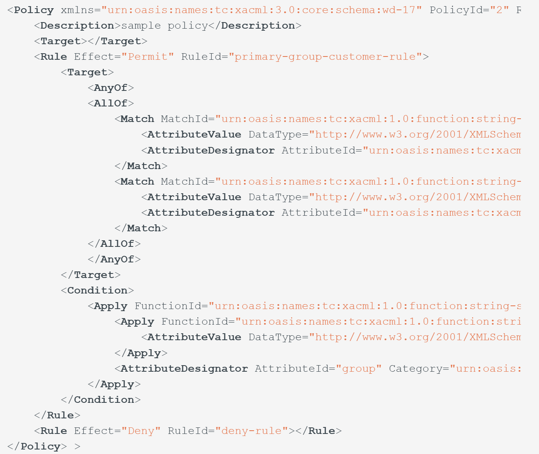
ABAC - XACML Example
Notes:
Look at this beautiful piece of XML art here. Any fans out there?

Slide 38
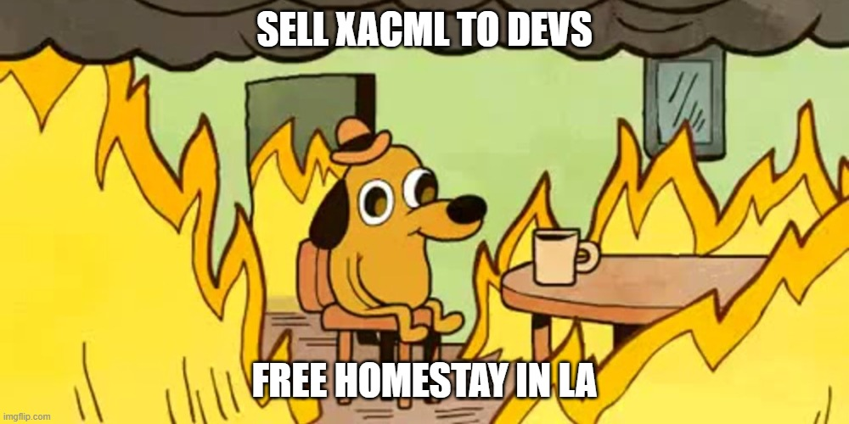

Slide 39


Slide 40
Google Zanzibar
Notes:
Then I came across something called Google Zanzibar. You might be thinking …

Slide 41
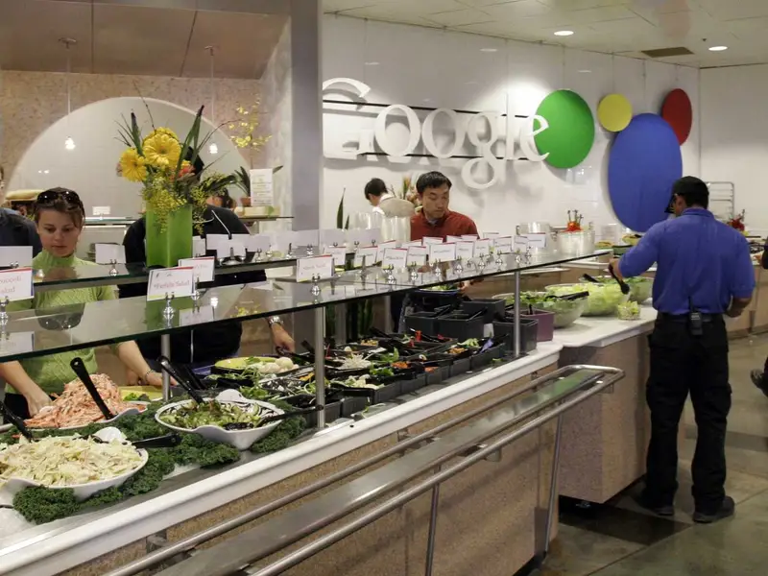
Google Zanzibar
Notes:
… is it their famous salad bar in their famed staff restaurants they have in their offices?

Slide 42
Google Zanzibar
Access Control System for all of Google’s Services (Internal + External)
Calendar, Cloud, Drive, Maps, Photos, and YouTube etc
95th-percentile latency of less than 10 milliseconds
Availability of 99.999% over 3 years
Notes:
50ms is considered a good time for an Authorisation call. In FBs, we had to increase our DataDog latency budget from 250ms to 600ms.

Slide 43
Google Zanzibar
Access Control Server for all of Google’s Services
Calendar, Cloud, Drive, Maps, Photos, and YouTube etc
95th-percentile latency of less than 10 milliseconds
Availability of 99.999% over 3 years
2 trillion relation tuples that occupy close to 100 terabytes
> 10 million client queries per second (QPS)
10,000 servers organized in several dozen clusters
Planetscale Numbers!
Notes:
50ms is considered a good time for an Authorisation call. In FBs, we had to increase our DataDog latency budget from 250ms to 600ms. Now you need to be wary, when you see the word PlanetScale bandied about

Slide 44

Notes:
Should be very wary when someone mentions PlanetScale, because this is what it usually means. Remember Kubernetes?

Slide 45
Pros & Cons with RBAC (Role based)
Pros
Simple
Easy to implement
Great for small/medium apps
Well defined Permission Set that doesn’t change
Cons
Not Scalable for Enterprise / SAAS
Difficult to change or introduce new permissions
Simple, Low Granular Permissions
Tight Coupling
Notes:
So I want to re-emphasise that if your use case lies within the blue points above, you should probably stick to RBAC, but perhaps use a solution that doesn’t imbed those Authorization logic in code as I demonstrated earlier

Slide 46

Google Zanzibar
Relationship based Access Control (ReBAC)
Notes:
In my earlier slide, I mentioned 2 trillion relation tuples, so that was a hint of what Zanzibar uses underneath

Slide 47
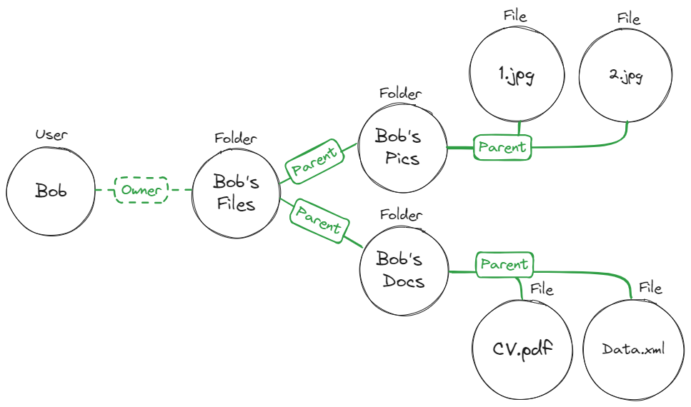

Relationship Based Access Control (ReBAC)
Notes:
At the heart of ReBAC, as the name implies is describing relationships between objects as a graph or a tuple

Slide 48
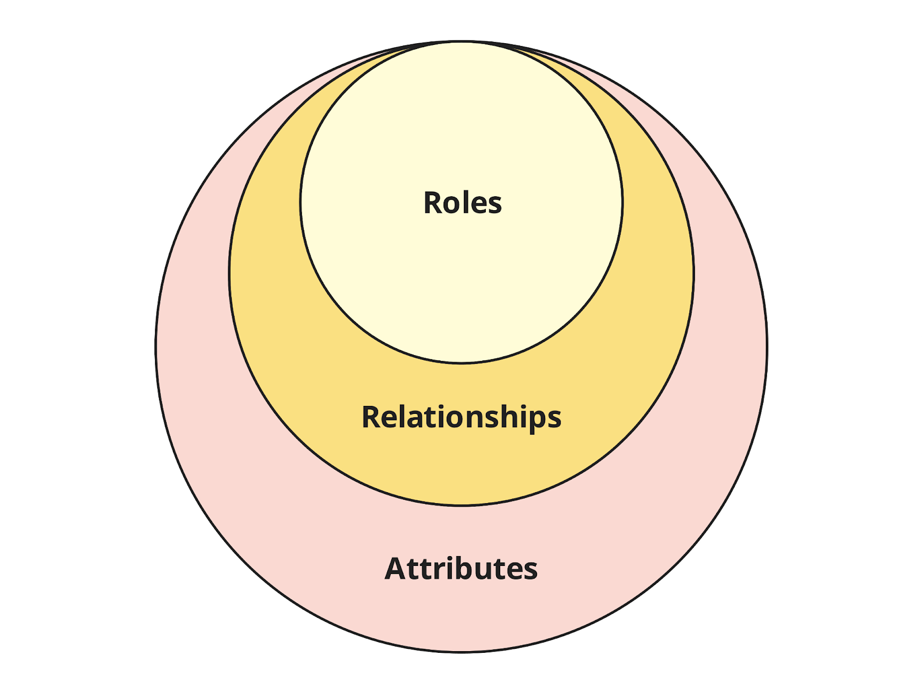

RBAC vs ReBAC vs ABAC - Concepts
Notes:
From conceptual viewpoint, Attributes > Relationships > Roles. If you’re thinking about moving from RBAC to ReBAC, the above graph tells you that a natural migration path exists

Slide 49
Relationship based Access Control (ReBAC)
Pros
Granular / Flexible Permissions
Scalable
Visual | Graphical
Centralised

Slide 50
Relationship based Access Control (ReBAC)
Pros
Granular / Flexible Permissions
Scalable
Visual | Graphical
Centralised
Cons
Relations can be complex to map
Learning curve - Graph Theory
Not as granular as ABAC
Auditing - Could be challenging
Notes:
XACML seems to be standard way of doing ABAC

Slide 51
Google Zanzibar Solutions
Open Source
SpiceDB
OpenFGA
Ory / Keto
Permify
Permit.io
Topaz
Commercial
Oso
Auth0 / Okta (OpenFGA)
Notes:
50ms is considered a good time for an Authorisation call. In FBs, we had to increase our DataDog latency budget from 250ms to 600ms.

Slide 52
Google Zanzibar Solutions
Open Source
SpiceDB
OpenFGA
Ory / Keto
Permify
Permit.io
Topaz
Commercial
Oso
Auth0 / Okta (OpenFGA)
Notes:
I’ll be doing a quick demo showcasing ReBAC concepts in Topaz

Slide 53

Topaz
Open Source
Supports Open Policy Agent (OPA) and Zanzibar
Supports RBAC, ABAC and ReBAC
Policies are expressed as code
Notes:
Open Policy Agent is an Cloud Native Computing Foundation Project that provides a way of declaratively writing policies as code (think Terraform for Policies)

Slide 54
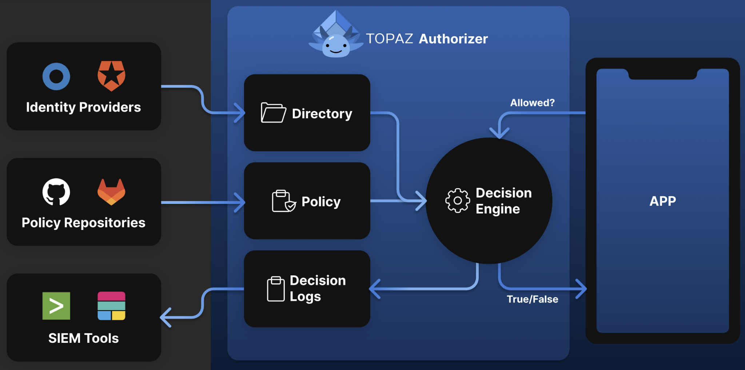
Topaz Architecture
Notes:
ID Providers does the Auth part (and you can connect external ones) Policy Repos are your data stores of your policies SIEM - Security Information and Event Managment - Real-time visibility across an organization's information security systems

Slide 55
Topaz - RBAC Example
allowed {
ds.check({
"object_type": "tenant",
"object_id": input.resource.tenant_id,
"relation": "viewer",
"subject_type": "user",
"subject_id": input.user.id,
})
}
Notes:
Json Syntax

Slide 56
Topaz - ReBAC Example
allowed {
ds.check({
"object_type": "document",
"object_id": input.resource.doc_id,
"relation": "can_read",
"subject_type": "user",
"subject_id": input.user.id,
})
}

Slide 57
Topaz - ABAC Example
allowed {
ns := time.now_ns()
day := time.weekday(ns)
day == data.workdays[_]
input.user.properties.department == "Sales"
}
Notes:
You’re passing the current time and day, you’re also passing in the workdays of the year (presumably), and the dept the user is in (Sales). Typical example of a policy being enforced

Slide 58
Topaz - ASP.NET Core Example
//Startup.cs
using Aserto.AspNetCore.Middleware.Extensions;
using Aserto.AspNetCore.Middleware.Policies;
// ...
//Aserto options handling
services.AddAsertoAuthorization(options => Configuration.GetSection("Aserto").Bind(options));
//end Aserto options handling
services.AddAuthorization(options =>
{
options.AddPolicy("Aserto", policy => policy.Requirements.Add(new AsertoDecisionRequirement()));
});
// ...
app.UseAuthorization();
//<Some>Controller.cs
[ApiController]
[Route("/todos")]
public class GetTodosController : ControllerBase
{
//...Some code
[HttpGet]
[Authorize("Aserto")]
public async Task<IEnumerable<TodoResource>> GetAllAsync()
{
var todos = await _todoService.ListAsync();
var resources = _mapper.Map<IEnumerable<Todo>, IEnumerable<TodoResource>>(todos);
return resources;
}
}
Notes:
<Show Code exam ple>

Slide 59
Topaz - Demo

Slide 60
Q & A

Slide 61
References
https://www.permit.io/blog/what-is-abac
https://www.permit.io/blog/what-is-rebac
https://permify.co/post/relationship-based-access-control-rebac/
https://www.osohq.com/academy/relationship-based-access-control-rebac
https://www.descope.com/learn/post/rebac
https://zanzibar.tech/2Dy8fNih7E:m:1Y
https://authzed.com/blog/what-is-google-zanzibar
https://workos.com/blog/what-is-rebac-relationship-based-access-control
https://www.permit.io/blog/conditions-vs-relationships-choosing-between-abac-and-rebac
https://www.descope.com/blog/post/rbac-vs-rebac
https://www.aserto.com/blog/abac-vs-rebac-fine-grained-access-control
https://www.youtube.com/watch?v=oW4QRTke-Oc
https://www.youtube.com/watch?v=qn6c-XNLdqw

